Slide 1

MOTIVATION AND EMOTIONAL PROCESS

Slide 2

A motive maybe considered as an energetic force or tendency working within the individual to compare or inspire him to act for the satisfaction of his basic needs or attainment of some specific purpose.
According to Rosen, fox and Gregory 'a motive maybe defined as a readiness or disposition to respond in some ways and not others to a variety of situations.

Slide 3
Concepts of Motivation
It compels an individual to respond by creating a kind of tension or urge act.
It is a goal directed activity pursued till the attainment of the goal.
Attainment of a Goal helps in the release of tension aroused by a specific motive.
Motivation is an inner state or an aroused feeling.
We cannot see motives directly but must infer them from the behaviour.
Motivation is generated through basic needs or urges.

Slide 4
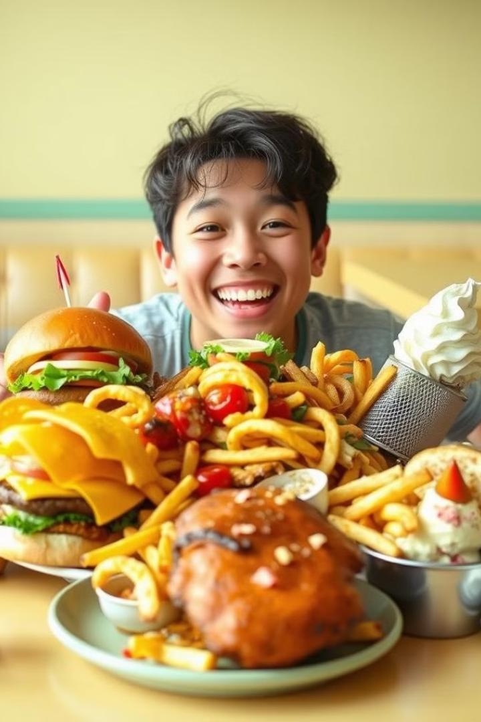
TYPES OF MOTIVES
Some psychologists divided motives into two main groups :-Innate or unlearned Acquired or learned.
Motivation can also be classified as Physiological or Primary motives, or social or secondary motives, personal motives and unconscious motives.
PHYSIOLOGICAL MOTIVES
Hunger Motive- the body's need for food is the basis of this motive. when we are hungry the need for food dominate everything else.
Thirst Motive- arises out of the need for quenching one's Thirst. it is found to be stronger than the hunger motive.

Slide 5

Sex motive- motivation to engage in sexual activity is a very strong factor influencing behaviour.
Respiratory motive- it is the drive for air and oxygen. one cannot survive for long without a regular supply of oxygen.
It is a medium of survival of the species and provide an individual a high level of satisfaction.

Slide 6
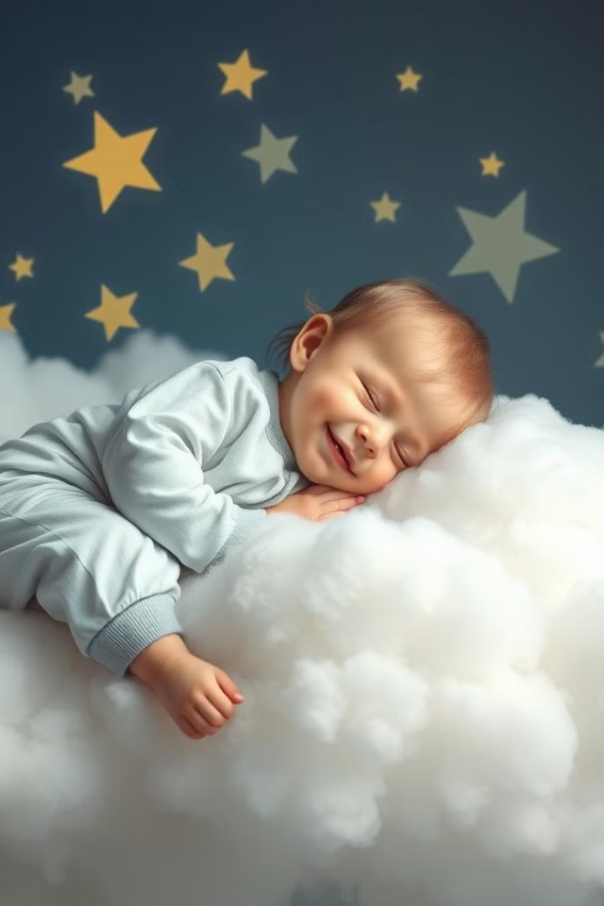
Need for elimination of waste- when bladder or intestine becomes filled with waste material ,they cause pressure and discomfort. And people have a motive to remove the waste.
Need for rest and sleep-when body continues activities without sleep or rest for a long time ,it is possible to experience confusion and discomfort.
So we have a need and motive to take rest.

Slide 7
SOCIAL OR SECONDARY MOTIVES
Need for status- almost all individuals have a desire to have some standing or position among the people of his society or group.
Affiliation motive- this directly springs from the need to be with other people.
Power Motive- The desire to be in a position of control, to be the boss, to give orders is called the power motive.
Seeking other fellow beings and wanting to be close to them both physically and psychologically is called affiliation.

Slide 8
PERSONAL MOTIVES
Need for achievement- it refers to a drive towards some standard of excellence.
Levels of aspiration- it imply the degree of expectation which a person has how much he expects to accomplish.
Vocational ambition- this desires are common to many others, but there is something unique about each one’s desires.
People with high need for achievement prefer task which would promise success and that are moderately difficult.

Slide 9

Force of habit- a habit which has been formed as a drive and compels us to continue the accustomed ways of doing things.
Interest and attitude- the interest we have developed and attitude we have formed colour our everyday behaviour in many ways.
People with high need for achievement prefer task which would promise success and that are moderately difficult.

Slide 10
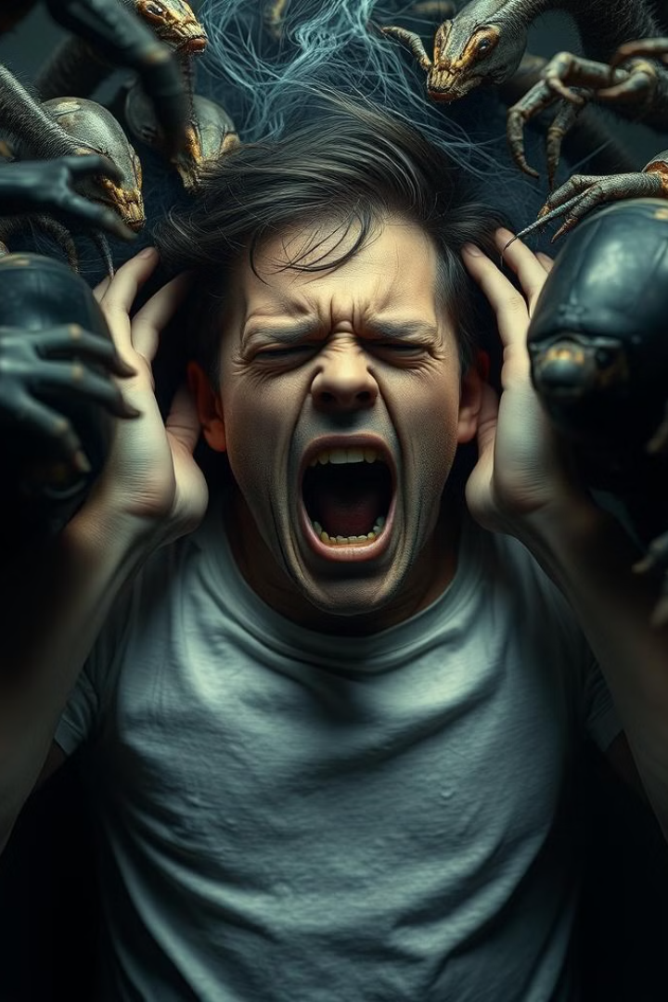
UNCONSCIOUS MOTIVES
These motives are those of which we are not aware of. they may be in the form of our repressed desires.
they determine our irrational fears or phobias, likes and dislikes etc.

Slide 11
THEORIES OF MOTIVATION
Instinct theory of motivation
William James and McDougall used the principles of instincts to explain human motivation.
According to Instinct theories, people are motivated to behave in certain ways because they are evolutionarily programmed to do so.
Later, this instinctual theory was restructured by Sigmund Freud.
William James claimed that instincts are of two kinds-those aroused within the individual and those aroused in the outer world.
example:- in animal world, seasonal migration. this animals do not learn to do this. it is instead an inborn pattern of behaviour.
McDougall makes a similar claim that all human behaviours are motivated by instincts.

Slide 12

DRIVE THEORY
Drive theory was developed by Clark Leonard in 1943.
According to drive theory of motivation, people are motivated to take certain actions in order to reduce the internal tension that is caused by unmet needs.
example:- a person might be motivated to drink a glass of water in order to reduce the internal state of thirst .
Four drives- hunger ,thirst, sex and avoidance of pain.
The theory is based on the idea that the body is constantly trying to maintain homeostasis, or balance.
When a need is not met, the body experiences internal tension, or a "drive".
To reduce this tension, the body is motivated to act in a way that meets the need.
Once the need is met, the tension subsides and the drive is no longer present.

Slide 13
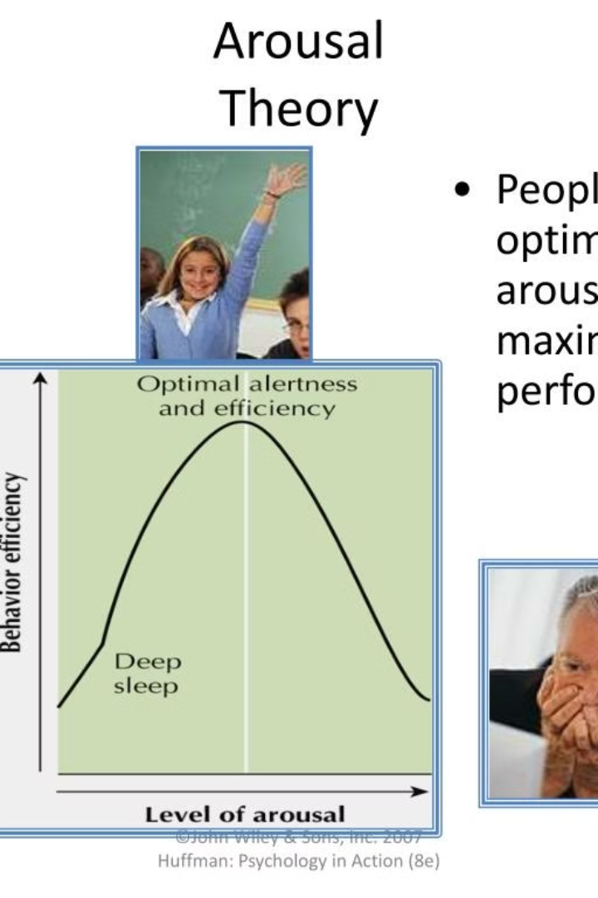
AROUSAL THEORY
Arousal is the level of alertness, wakefulness and activation caused by activity in the central nervous system.
The arousal theory of motivation suggests that people takes certain actions to either decrease or increase levels of arousal.
When arousal levels are too low , a person might watch an exciting movie or go for a jog.
When arousal levels get too High, a person look for ways to relax such as meditating or reading a book.

Slide 14

INCENTIVE THEORY(PULL THEORY)
It is based on behaviourists learning theories proposed by Thorndike, Watson and Skinner.
The incentive theory suggest that, people are motivated to do things because of external rewards.
Eg:- a student is motivated by the incentive of trophy for good grades.

Slide 15
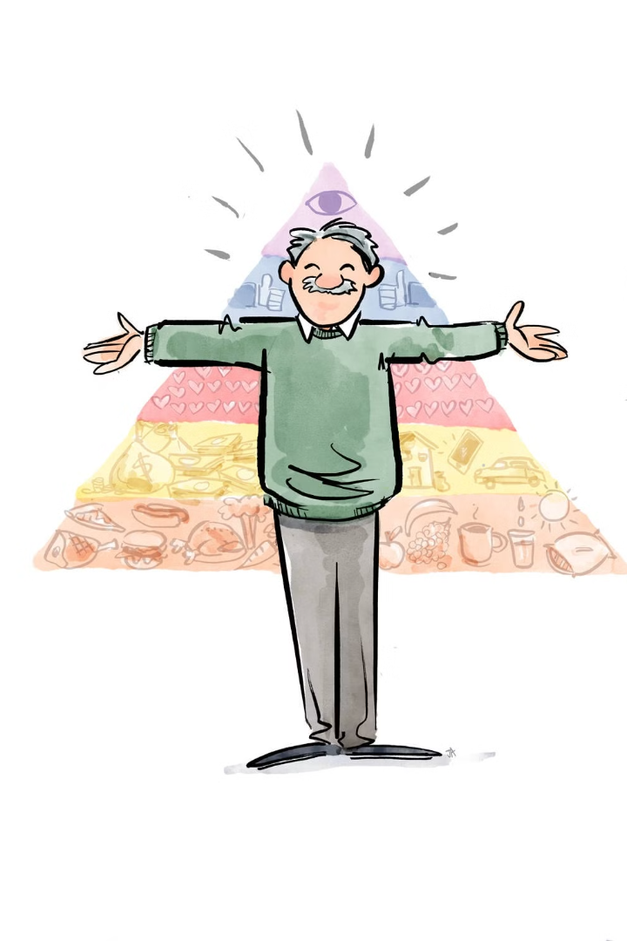
MASLOW'S HIERARCHY OF NEEDS
•Abraham Maslow proposed hierarchy of needs.
•His basic theme is that motivation, affects the person as a whole rather than just a part.
•He suggested 5 basic classes of needs that influence human behaviour .
•According to Maslow, needs at the lowest level of hierarchy satisfied before can be motivated by higher level goals.

Slide 16
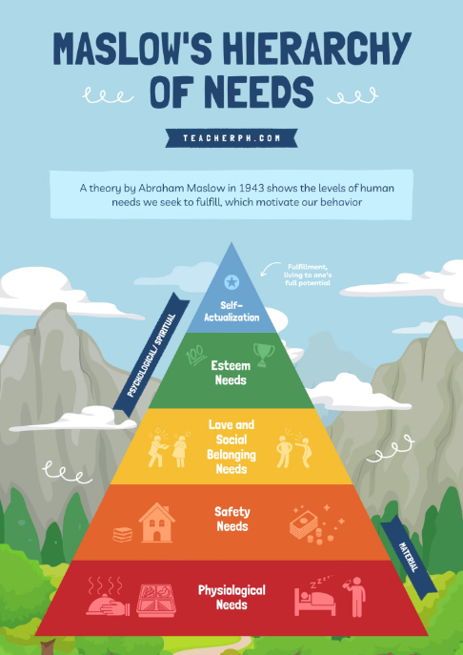
Physiological needs- the most basic and urgent of all human needs.
Eg:- food ,water, oxygen ,sleep , sex.
Safety and security needs- once physiological needs are satisfied ,safety and security needs predominate.
Safety needs are very important in childhood. the failure to satisfy needs of children may make the fearful and insecure adults.
Need for love and belongingness-the person at this level longs for affectionate relationship with others like family and social groups and sexual intimacy.

Slide 17
Self esteem needs- once people find themselves loved and loving members, they want self respect ,confidence and admiration of others.
Self actualization- according to Maslow, self actualization is the highest human Motive.
It is the need for self fulfilment, the sense that one is becoming everything that he is capable of being and using full potential.
Dissatisfaction of self esteem needs generates feeling of inferiority and weakness.
self actualized people are realistically oriented ,problem centered, they have a need for privacy, more independent , intimate relations, good sense of humour.

Slide 18
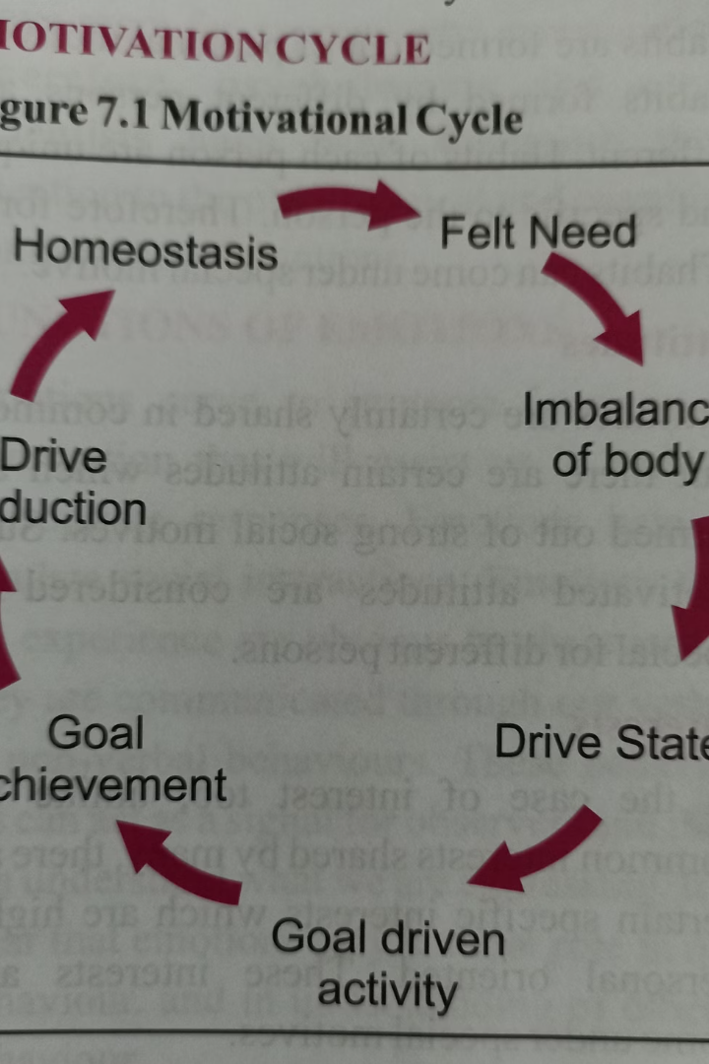
MOTIVATION CYCLE
Drive theories says, when an internal drive state is aroused, the individual is pushed to engage in behaviour which will lead to a goal, reducing the intensity of the drive state. Motivation consists of a :-
Drive state.
Goal directed behaviour initiated by the drive state.
The attainment of an appropriate goal.
The reduction of the drive state and subjective satisfaction and relief when the goal is reached.
• The sequence of events is called motivational cycle.

